Slide 1
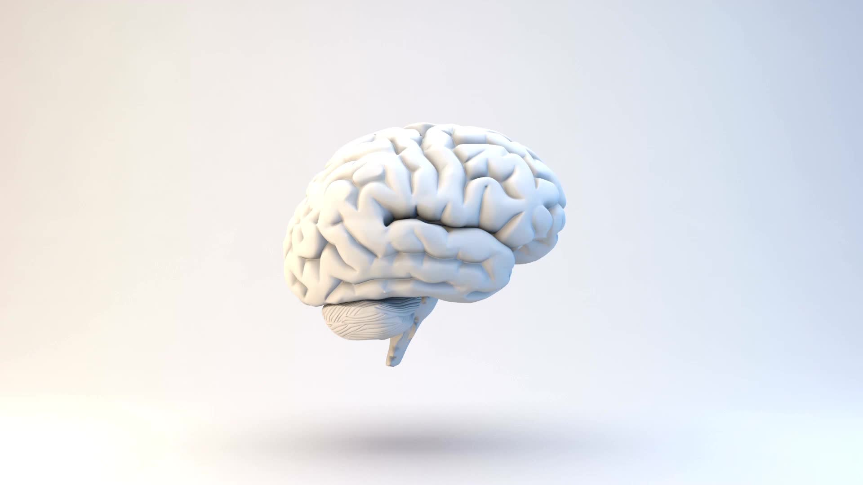
THE CIRCULATORY SYSTEM AND HOW IT WORKS
Kailen and Elizabeth

Slide 2
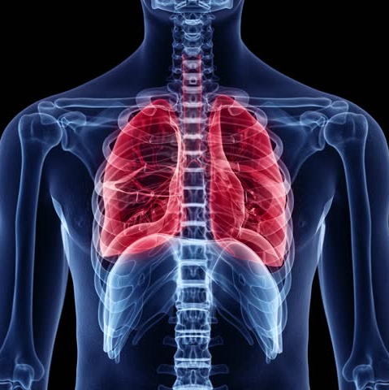
WHAT IS THE CIRCULATORY SYSTEM?
The circulatory system is the system that circulates blood and lymph through the body, consisting of the heart, blood vessels, blood, lymph, and the lymphatic vessels and glands .Also called cardiovascular system.

Slide 3
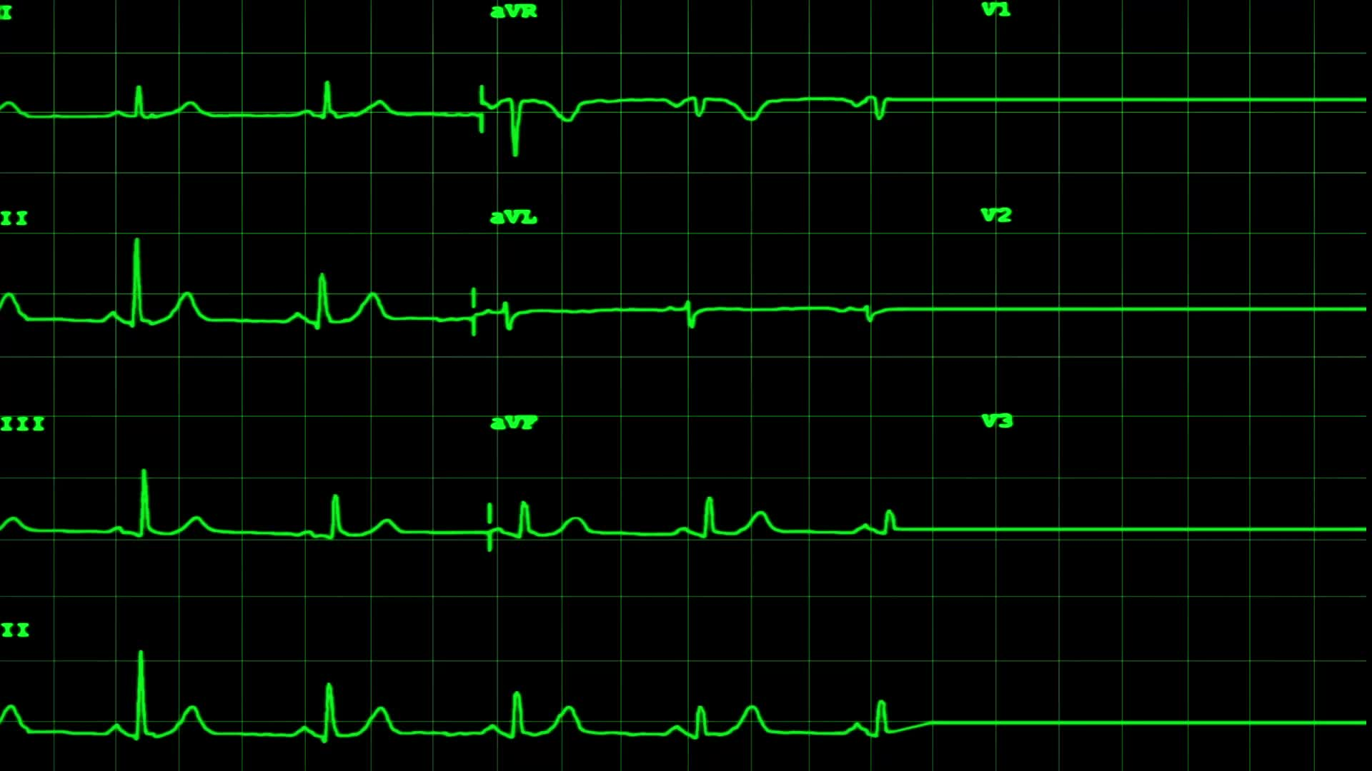
HOW THE HEART WORKS
Heart: The muscle that pumps blood received from veins into arteries throughout the body. The heart is positioned in the chest behind the sternum (breastbone); in front of the trachea, esophagus, and aorta; and above the diaphragm.

Slide 4
HOW THE BLOOD CELLS WORK
Blood cells develop from hematopoietic stem cells(An immature cell that can develop into all types of blood cells) and are formed in the bone marrow through the highly regulated process of hematopoiesis. Hematopoietic stem cells are capable of transforming into red blood cells, white blood cells, and platelets.
Unlike red and white blood cells, platelets are not actually cells but rather small fragments of cells. Platelets help the blood clotting process (or coagulation) by gathering at the site of an injury, sticking to the lining of the injured blood vessel, and forming a platform on which blood coagulation can occur.

Slide 5
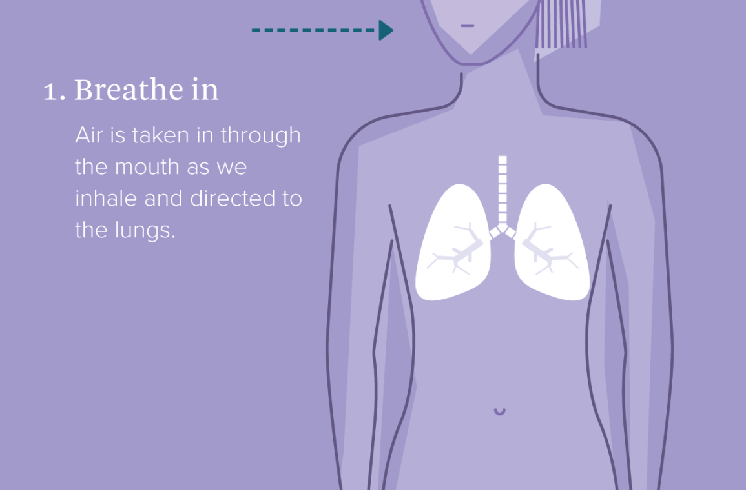
HOW DO LUNGS WORK?
The lungs are a pair of spongy, air-filled organs located on either side of the chest (thorax). The trachea (windpipe) conducts inhaled air into the lungs through its tubular branches, called bronchi. The bronchi then divide into smaller and smaller branches (bronchioles), finally becoming microscopic.

Slide 6
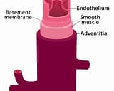
HOW DO THE VEINS WORK?
A blood vessel that carries blood that is low in oxygen content from the body back to the heart. The deoxygenated form of hemoglobin (deoxy-hemoglobin) in venous blood makes it appear dark. Veins are part of the afferent wing of the circulatory system, which returns blood to the heart.

Slide 7
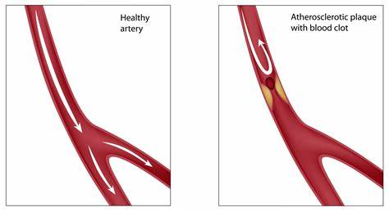
HOW THE ARTERIES WORK
An artery is a vessel that carries blood high in oxygen content away from the heart to the farthest reaches of the body. Since blood in arteries is usually full of oxygen, the hemoglobin in the red blood cells is oxygenated

Slide 8
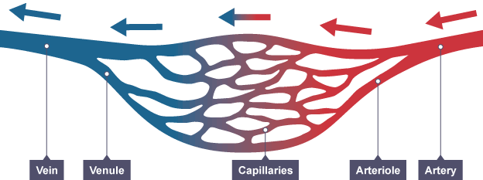
HOW DO CAPILLARIES WORK?
The walls of capillaries are just one cell thick. Capillaries therefore allow the exchange of molecules between the blood and the body's cells - molecules can diffuse across their walls. This exchange of molecules is not possible across the walls of other types of blood vessel.

Slide 9
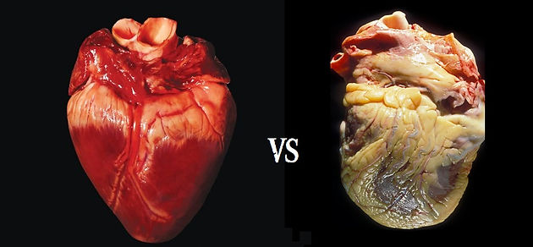
WAYS TO KEEP YOUR HEART HEALTHY:
1. Give up smoking. If you're a smoker, quit.
2. Get active.
Getting – and staying – active can reduce your risk of developing heart disease.
3. Manage your weight. Being overweight can increase your risk of heart disease.
4. Eat more fibre. Eating plenty of fibre can help lower your risk of heart disease
5. Cut down on saturated fat-eating too many foods that are high in saturated fat can raise the level of cholesterol in your blood.
6. Get your 5 A Day-eat at least 5 portions of a variety of fruit and vegetables a day.

Slide 10
THANK YOU FOR WATCHING!
Kailen and elizabeth`s powerpoint

