Slide 1

Learn about your circulatory system

Slide 2
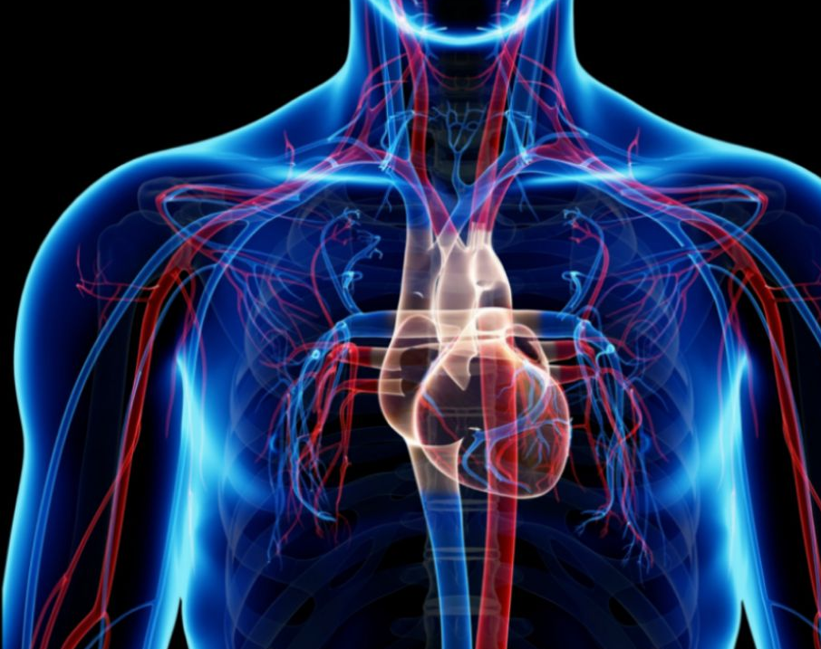
Human body
The circulatory system is made up of blood vessels that carry blood away from and towards the heart. Arteries carry blood away from the heart and veins carry blood back to the heart. The circulatory system carries oxygen, nutrients, and hormones to cells.

Slide 3
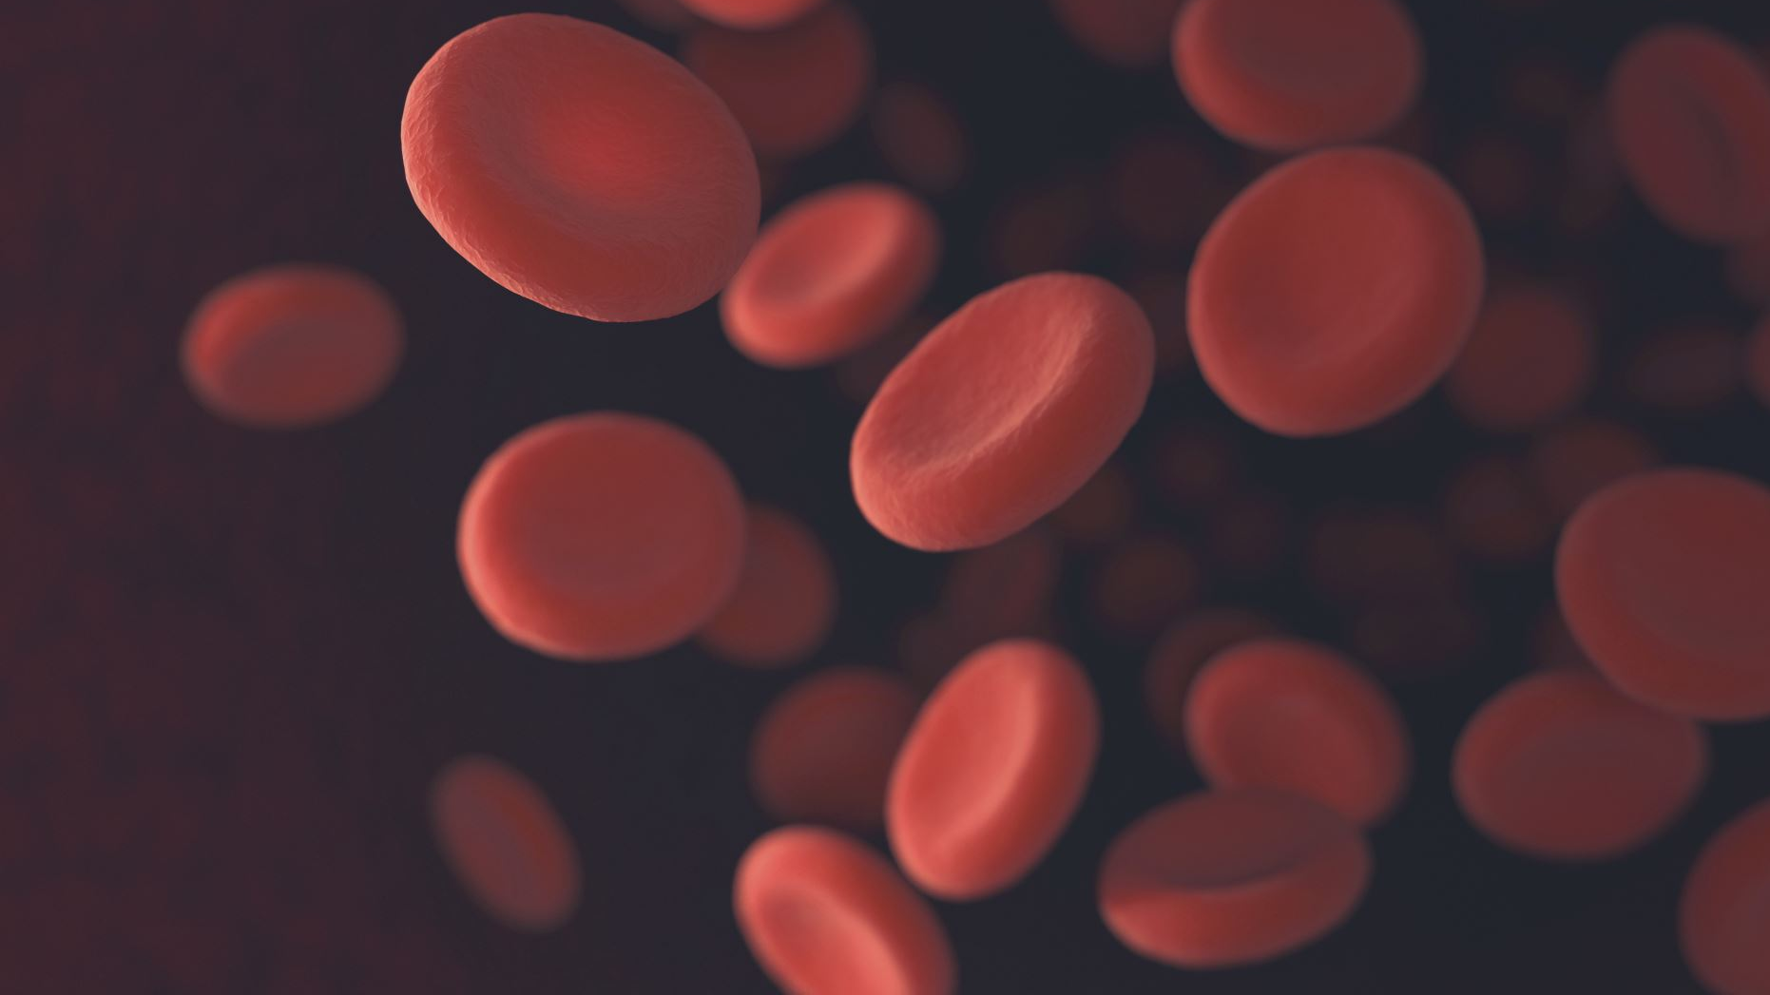
What does blood do ? blood keeps us alive by carrying oxygen around our bodyies . There are different types of blood .The blood also carry blood cells ,there is white blood cells [wbc] and red blood cells[rbc]

Slide 4
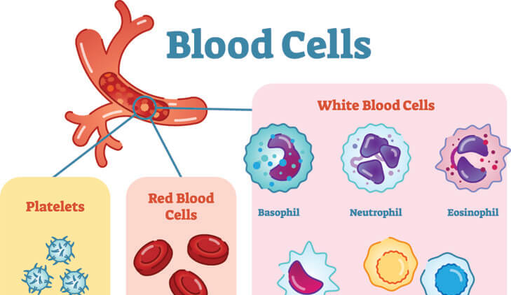
What are the job of blood cells ?
Your blood carries oxygen and nutrients to all of the cells in your body. Blood cells also fight infection and control bleeding. Most blood cells are made in your bone marrow. ... Your blood is made up of 4 parts: red blood cells, white blood cells, platelets, and plasma.

Slide 5
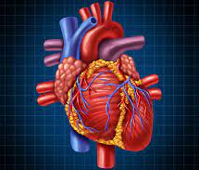
Heart
The heart is part of your body’s circulatory system. It’s made up of the atria, ventricles, valves, and various arteries and veins. The main function of your heart is to keep blood that’s full of oxygen circulating throughout your body. Because your heart is crucial to your survival, it’s important to keep it healthy with a well-balanced diet and exercise, and avoid things that can damage it, like smoking.

Slide 6
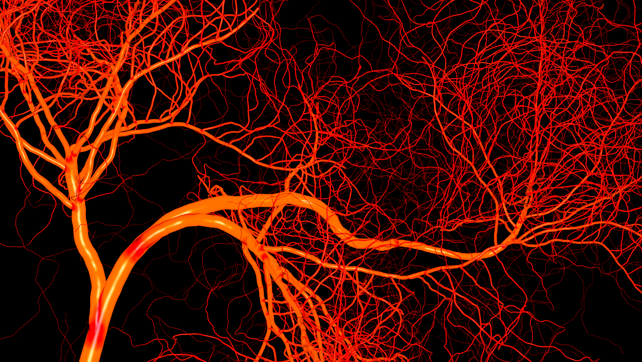
vessels
There are three kinds of blood vessels: arteries, veins, and capillaries. Each of these plays a very specific role in the circulation process. Arteries carry oxygenated blood away from the heart. They're tough on the outside but they contain a smooth interior layer of epithelial cells that allows blood to flow easily.

Slide 7
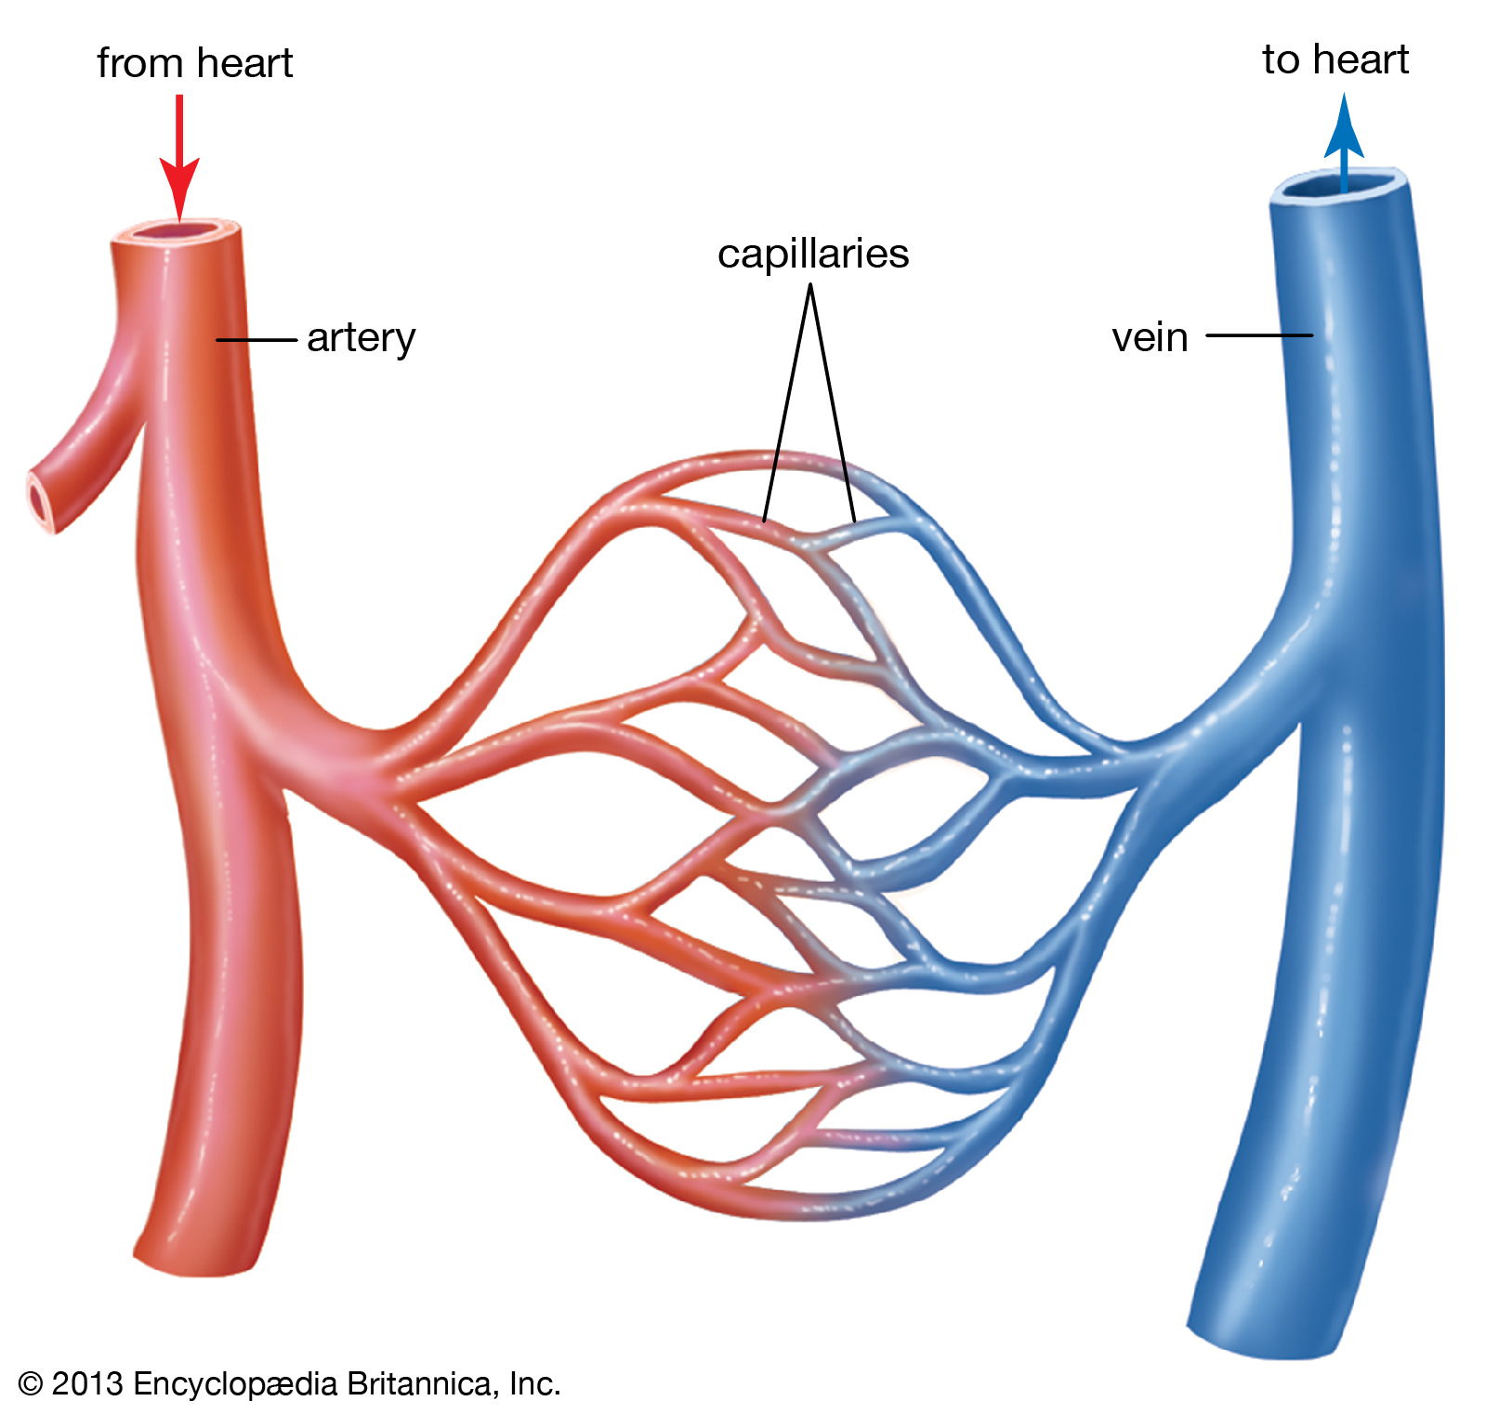
vein
Veins are a type of blood vessel that return deoxygenated blood from your organs back to your heart. These are different from your arteries, which deliver oxygenated blood from your heart to the rest of your body. ... Capillaries are the smallest blood vessels in your body.

Slide 8
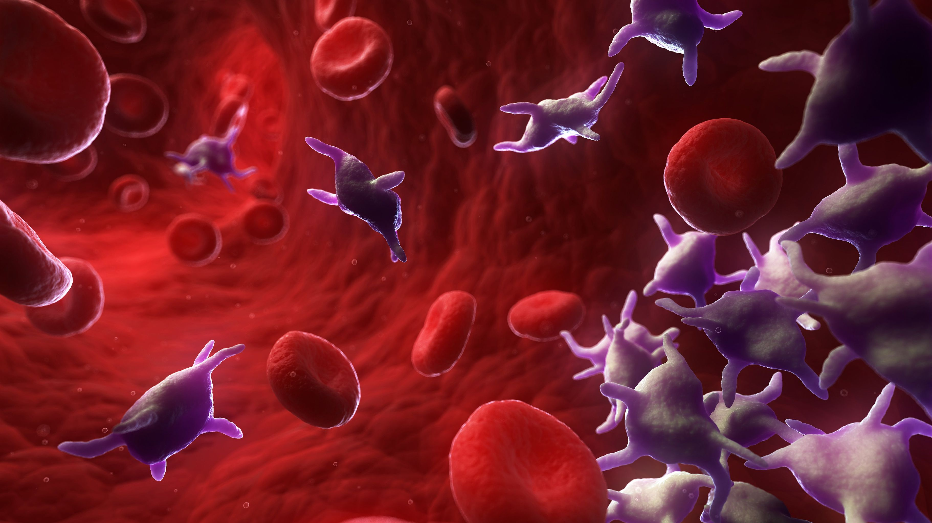
Platelets platelets platelets (thrombocytes) are colorless blood cells that help blood clot. Platelets stop bleeding by clumping and forming plugs in blood vessel injuries. Thrombocytopenia might occur as a result of a bone marrow disorder such as leukemia or an immune system problem.

Slide 9
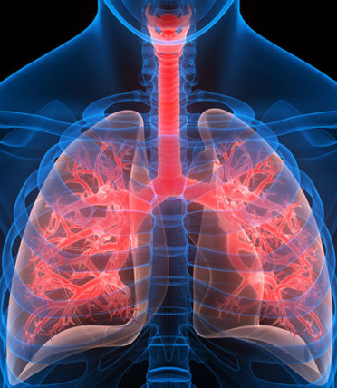
lungs
The lungs are a pair of spongy, air-filled organs located on either side of the chest (thorax). The trachea (windpipe) conducts inhaled air into the lungs through its tubular branches, called bronchi. ... In the alveoli, oxygen from the air is absorbed into the blood

Slide 10

The ending 😥
Now you know all about the circulatory system, and if you receive a question you should get it correct
By Faris and Peter

