Slide 2



Diving into Mastery Guidance for Educators
Each activity sheet is split into three sections, diving, deeper and deepest, which are represented by the following icons:
These carefully designed activities take your children through a learning journey, initially ensuring they are fluent with the key concept being taught; then applying this to a range of reasoning and problem-solving activities.
These sheets might not necessarily be used in a linear way. Some children might begin at the ‘Deeper’ section and in fact, others may ‘dive straight in’ to the ‘Deepest’ section if they have already mastered the skill and are applying this to show their depth of understanding.
Diving
Deeper
Deepest

Slide 3
Aim
Recall and use equivalences between simple fractions, decimals and percentages, including in different contexts.

Slide 4
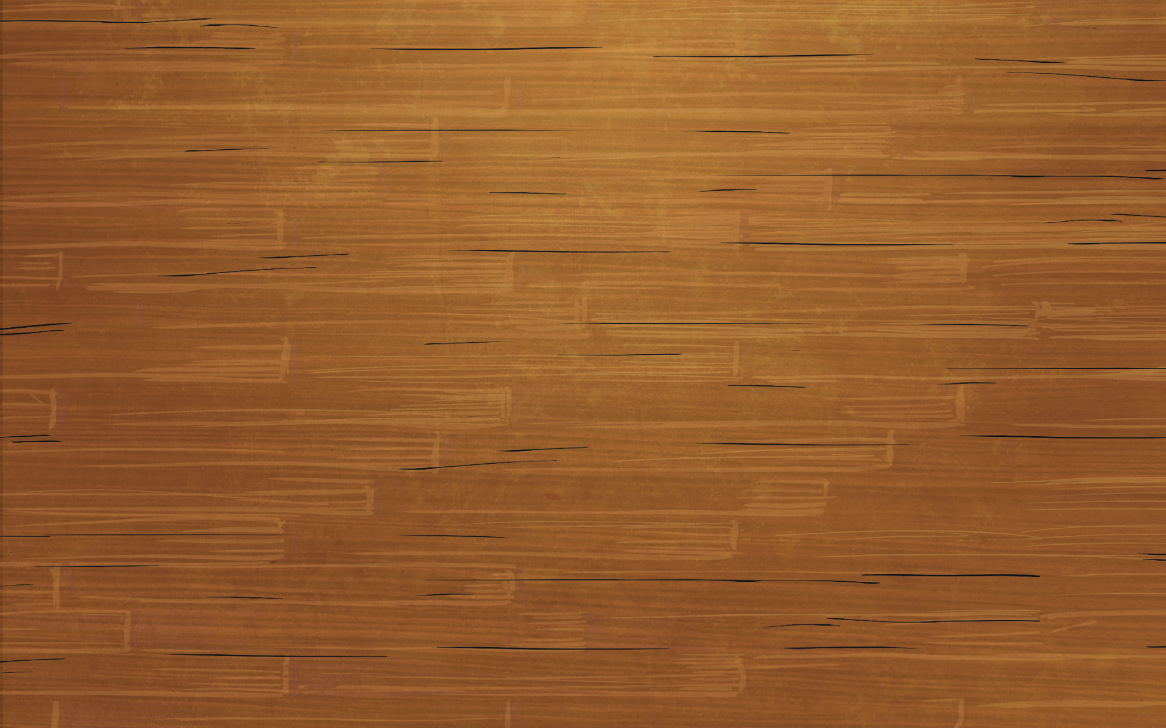

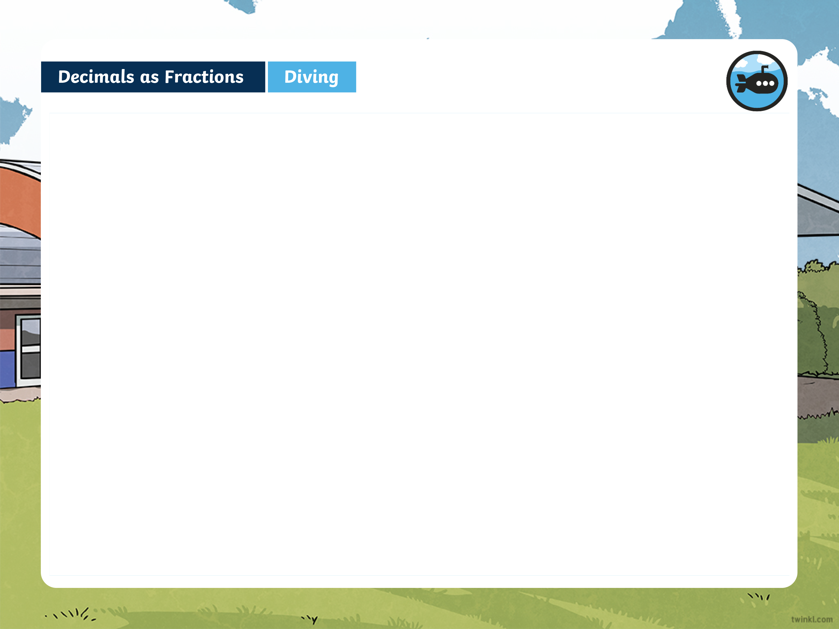
Decimals as Fractions
Diving
Complete the table with the correct equivalences between the fractions and decimals that are shown.
Decimal | Fraction (With a Denominator of 10 or 100) | Simplified Fraction (If the Fraction Can Be Simplified)
5
1
0.5
10
2
75
0.75
100

Slide 5
Decimals as Fractions
Diving
Complete the table with the correct equivalences between the fractions and decimals that are shown.
Decimal | Fraction (With a Denominator of 10 or 100) | Simplified Fraction (If the Fraction Can Be Simplified)
3
0.6
5
0.1
0.1
0.1
0.1
8
4
10
5
0.1
0.1
0.1
0.1

Slide 6
Decimals as Fractions
Diving
Complete the table with the correct equivalences between the fractions and decimals that are shown.
Insert the missing digits so that these statements show the correct fraction to decimal equivalents.
Decimal | Fraction (With a Denominator of 10 or 100) | Simplified Fraction (If the Fraction Can Be Simplified)
90
9
0.9
=
=
100
10
125
1
0.125
3
0.6
=
=
1000
8
5
0.1
0.1
0.1
0.1
8
4
20
1
2
=
=
0.
10
5
0.1
0.1
0.1
0.1
100
5

Slide 7


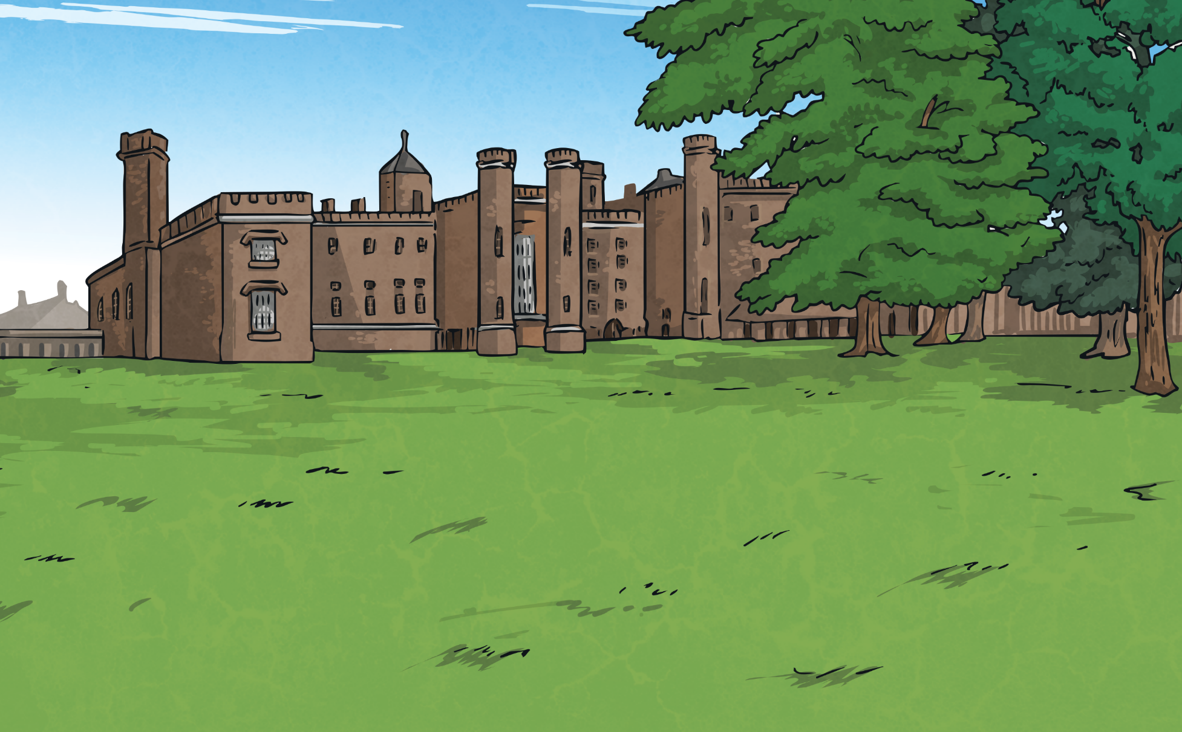
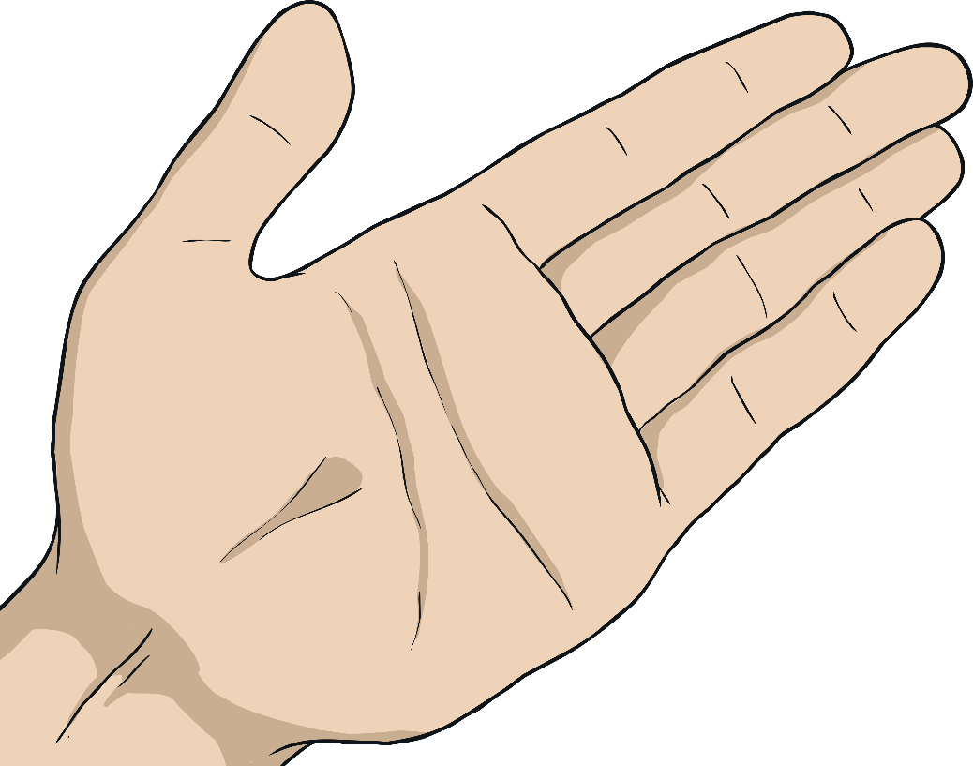
Decimals as Fractions
Deeper
True or False? Explain your answers using the equivalence
between fractions and decimals.
1
This is false as 0.01 is equivalent to one hundredth.
1
0.01 =
0.01 =
100
10
550
This is true. If we simplified the fraction, it would be .
55
0.55 =
1000
0.55 =
100
55
100
1
1
This is false as 0.8 is equivalent to .
0.125 =
0.8 =
8
8
8
10

Slide 8

Decimals as Fractions
Deepest
The three shapes each represent a different single-digit whole number. Read the statements about the numbers to help you work out each shape’s value:
A triangle is worth one less than a pentagon.
A square is worth one less than a triangle.
One of the shapes represents an odd number.
0
1
2
1
=
1
2
1
1
0
0
0

Slide 9


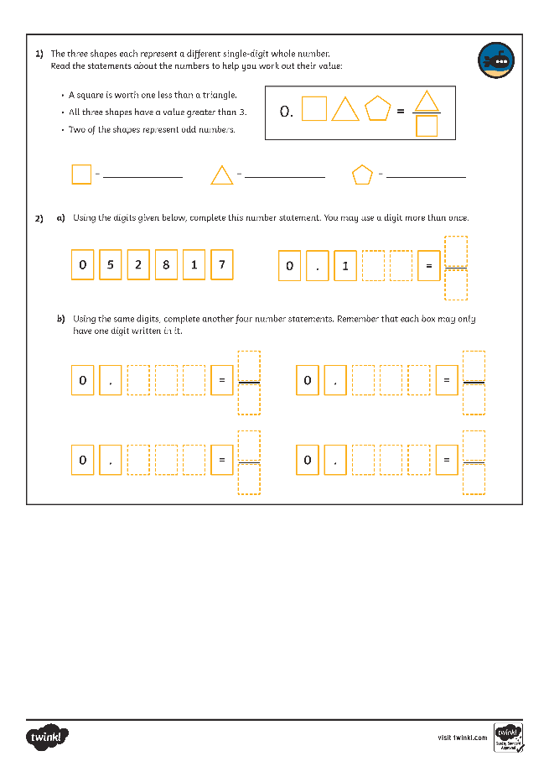
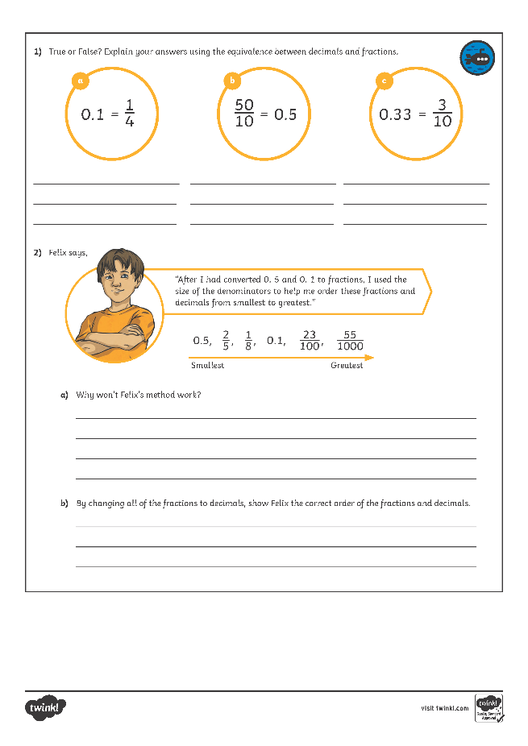
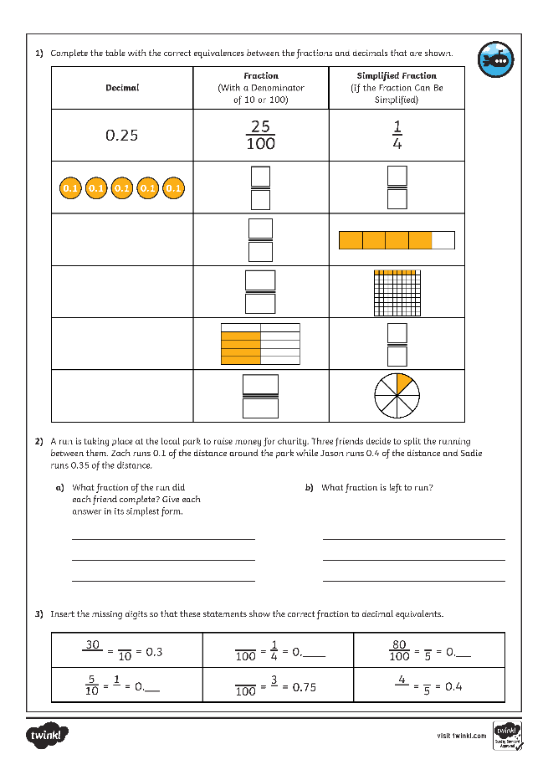
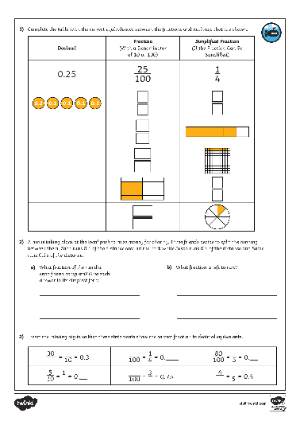
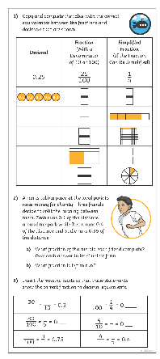
Decimals as Fractions
Dive in by completing your own activity!

