Slide 1
Physical Development in the Early Foundation Stage
11th January 2023

Slide 2
What is Physical Development?
Physical development is one of the three prime areas for learning and development within the statutory framework for the early years foundation stage. These prime areas for learning and development are fundamentally important within early years education, as it is these prime areas that form the foundations to which all further learning is built upon.

Slide 3
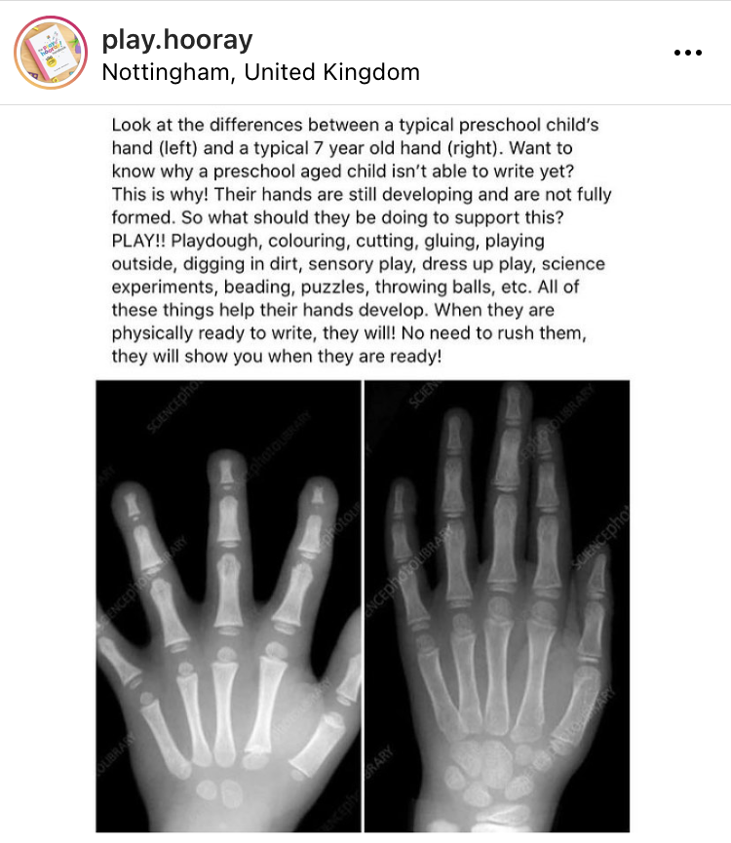
Take a moment to consider..

Slide 4
When to start Physical Development
Before teaching children the correct pencil grip and posture for writing, or how to use a knife and fork and cut with scissors, check:
that children have developed their upper arm and shoulder strength sufficiently: they do not need to move their shoulders as they move their hands and fingers
that they can move and rotate their lower arms and wrists independently’

Slide 5
Physical Development (Early Learning Goals)
Gross Motor Skills
Children at the expected level of development will:
Negotiate space and obstacles safely, with consideration for themselves and others;
Demonstrate strength, balance and coordination when playing;
Move energetically, such as running, jumping, dancing, hopping, skipping and climbing.
Fine Motor Skills
Children at the expected level of development will:
Hold a pencil effectively in preparation for fluent writing – using the tripod grip in almost all cases;
Use a range of small tools, including scissors, paint brushes and cutlery;
Begin to show accuracy and care when drawing.

Slide 6
The importance of Physical Development and Early Writing Skills
Children need to:
Make connections in the brain + Develop strong muscles + Develop co-ordination
(Maturity) (Physical Development) (Perceptual Awareness)
How do you know when children have the maturity and the skills ready for writing?
Can they balance on one leg for 8 seconds?
Can they support their own body weight when doing a press up in the proper press up position?
Can they touch finger on their hand in turn with their thumb?
Can they lift their knee and touch with the opposite hand alternately?
Can they crawl?

Slide 7
Activities to support Gross and Fine Motor Skills
Moving in different ways (hopping, jumping and balancing)
Managing self-care needs including independently zipping up their coat and putting on their belongings
Rolling, catching and throwing a ball
Scissors
Threading
Playdough
Puzzles
Threading/Small World Play
Water and play

Slide 8
Let’s have a go!

