Slide 2
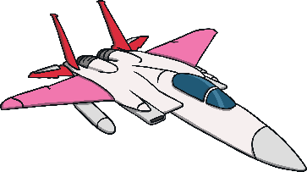

plane
Start Timer
Start Timer
Next
Use Timer
Show Answer

Slide 3
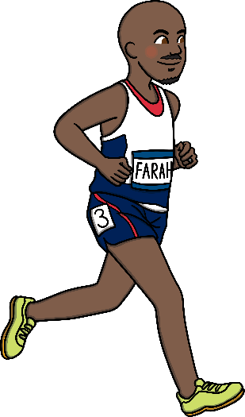
athlete
Start Timer
Start Timer
Next
Use Timer
Show Answer

Slide 4
chite
Use Timer
Show Answer
Start Timer
Start Timer
Next

Slide 5
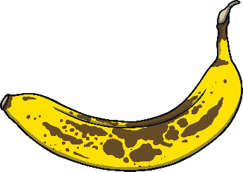
ripe
Start Timer
Start Timer
Next
Use Timer
Show Answer

Slide 6
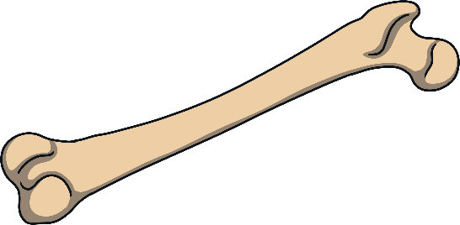
bone
Start Timer
Start Timer
Next
Use Timer
Show Answer

Slide 7
flute
Start Timer
Start Timer
Next
Use Timer
Show Answer

Slide 8

cute
Start Timer
Start Timer
Next
Use Timer
Show Answer

Slide 9

whale
Start Timer
Start Timer
Next
Use Timer
Show Answer

Slide 10
sheme
Use Timer
Show Answer
Start Timer
Start Timer
Next

Slide 11

complete
Start Timer
Start Timer
Next
Use Timer
Show Answer

Slide 12

time
Start Timer
Start Timer
Next
Use Timer
Show Answer

Slide 13
chope
Use Timer
Show Answer
Start Timer
Start Timer
Next

Slide 14
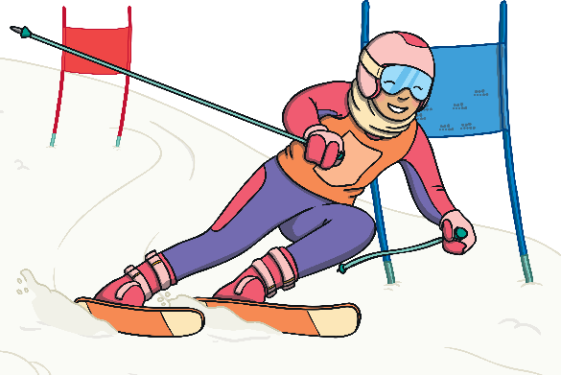
slope
Start Timer
Start Timer
Next
Use Timer
Show Answer

Slide 15

fume
Start Timer
Start Timer
Next
Use Timer
Show Answer

Slide 16
dube
Use Timer
Show Answer
Start Timer
Start Timer
Next

Slide 17

tube
Start Timer
Start Timer
Next
Use Timer
Show Answer

Slide 18
plave
Use Timer
Show Answer
Start Timer
Start Timer
Next

Slide 19
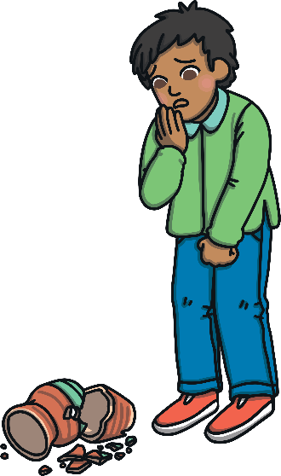
mistake
Start Timer
Start Timer
Next
Use Timer
Show Answer

Slide 20
thene
Use Timer
Show Answer
Start Timer
Start Timer
Next

Slide 21

extreme
Start Timer
Start Timer
Next
Use Timer
Show Answer

Slide 22

inside
Start Timer
Start Timer
Next
Use Timer
Show Answer

Slide 23
splove
Use Timer
Show Answer
Start Timer
Start Timer
Next

Slide 24

explode
Start Timer
Start Timer
Next
Use Timer
Show Answer

Slide 25
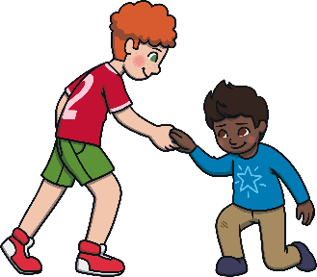
include
Start Timer
Start Timer
Next
Use Timer
Show Answer

Slide 26
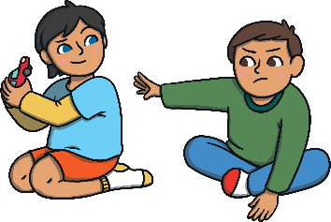
dispute
Start Timer
Start Timer
Next
Use Timer
Show Answer

